Slide 1
Agile/Scrum Workshop
By Peter Asher
Notes:
Give a disclaimer about how you don’t do things totally by the book.

Slide 2
What we will cover:
What is Agile?
What is Scrum?
Why would I want to use Agile/Scrum?
Scrum Roles
Scrum Meetings
Standup
Storytime
Planning
Review
Retro
Storytime Demo
Using Scrum w/ Trello
Please ask questions!

Slide 3
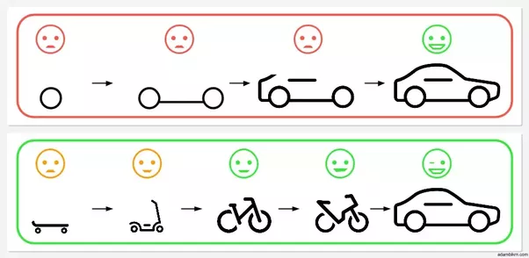
What is Agile?
Agile is a philosophy that emphasizes:
Adaptability
Iterability
Communication
Notes:
Like Subway:
You, the customer/stakeholder, have a say in every part of the process that leads to the end result. You are communicating w/ the product team to make sure that every step in the process is influenced by you, and you can change your mind at any point in the sandwich production.
Emphasize that it’s originally a SWDev philosophy but is also used for many other tracks as well
It’s more philosophical than concrete

Slide 4
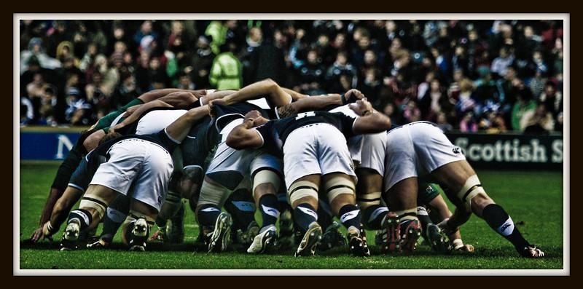
What is Scrum?
Scrum:
Is a framework for implementing Agile
Is committed to iterations of work called “Sprints”
Gives team members more ownership of process
Can be adapted for any team
Notes:
A framework is a set of rules and processes by which you can implement a philosophy, like agile
You need this so you have an idea of HOW to go about implementing the philosophy, and you’re not just guessing

Slide 5
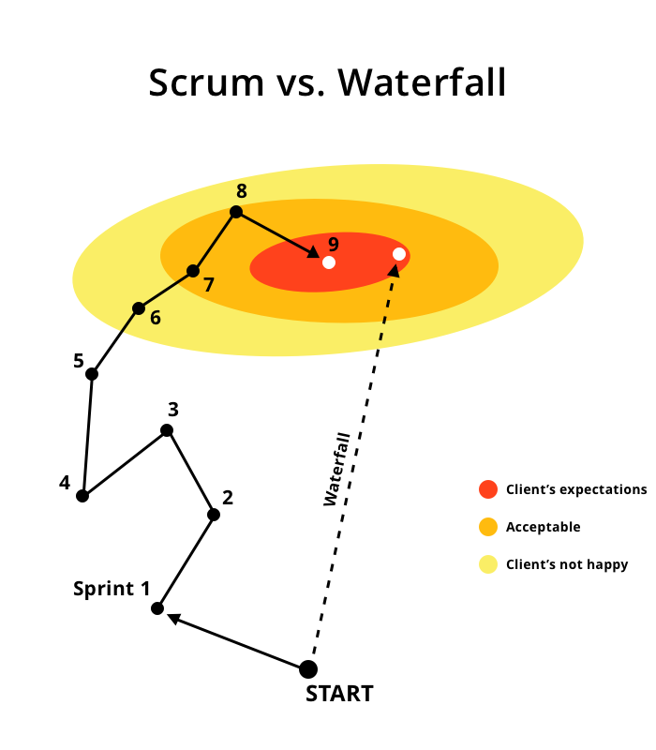
When to use Agile/Scrum?
You have changing constraints:
Time
Resources
Deliverables
You want your work process to be able to change to fit your needs
You want your team to be more accountable & responsible
Notes:
Eitan eloquently said: the thing you set out to build on day 1 one is never the same thing that you ultimately deliver when the work is done, because requirements always change - whether those requirements come from a customer, boss, or another team. So "agility" is the ability to respond to change and end up building the right thing.
Talk about waterfall & why scrum is in opposition

Slide 6

How does Scrum work?

Slide 7
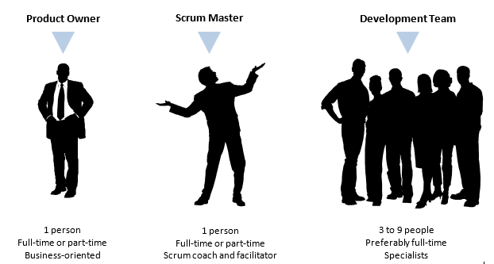
Scrum Roles
Product Owner - The Visionary
The link between business & team
Prioritizes tasks
Has vision for product
Scrum Master - The Facilitator
Introduces/maintains Scrum
Gradually disappears over time
Team Member - The Builder
Produces the actual work
Breaks down goals into sprint-sized tasks with Product Owner
Figures out how to complete tasks
Notes:
Disclaimer: These roles are described how they fit w/ Umuzi
Michelle says: Use concrete detail examples since the roles are amorphous at Umuzi

Slide 8
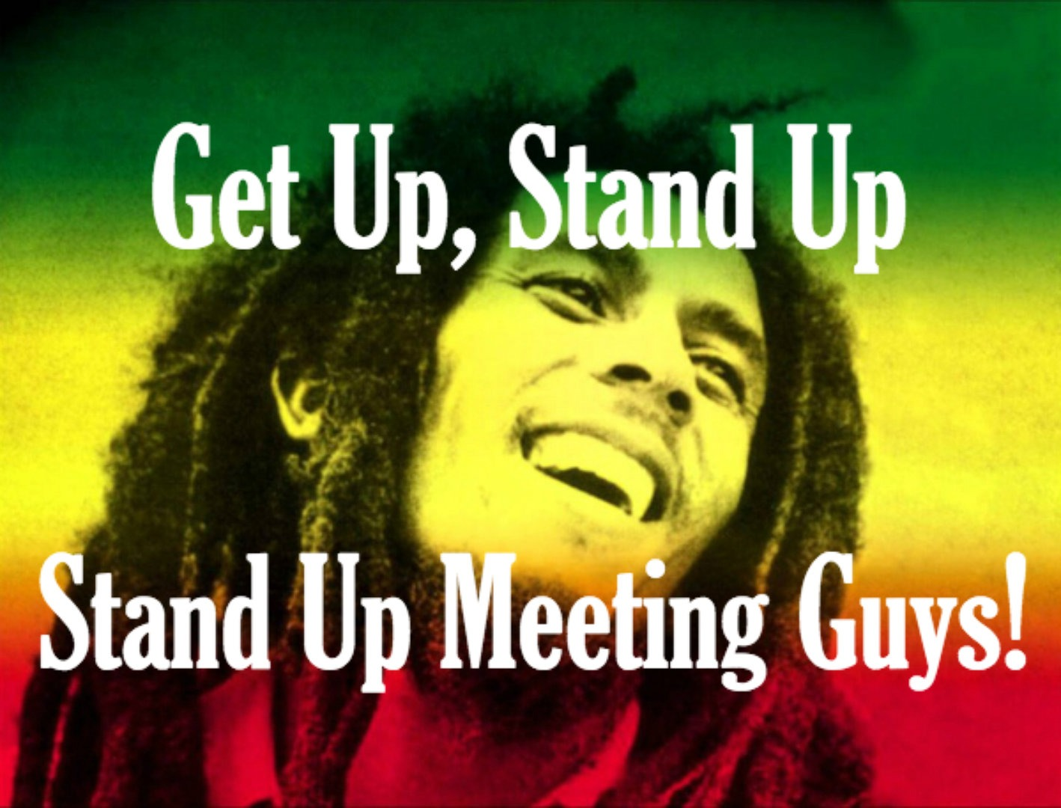
Scrum Meetings - Standup
When: Every morning
What: Sync-up. Each team member answers each of the following questions:
What did you do yesterday?
What will you do today?
Are there any impediments?
All other discussions are tabled until after the meeting “after-topics”
Why: Quickly adapt to roadblocks and to initiate discussions.
Encourages team to self-police and identify points of improvement.

Slide 9

Scrum Meetings - Story Time
When: As needed. 2-3+ sprint's worth of tasks (tickets) should be in the backlog at all times.
What: The team hashes out different user stories with the product manager, and converts them into tickets that are bite-sized, have a time estimate/maximum, and possess unambiguous requirements.
Why: So every ticket is clear on what needs to be accomplished. It is easier to prioritize what needs to be done when you know how long it will take.
Notes:
Go from vague & high-level stories to granular and specific tickets

Slide 10
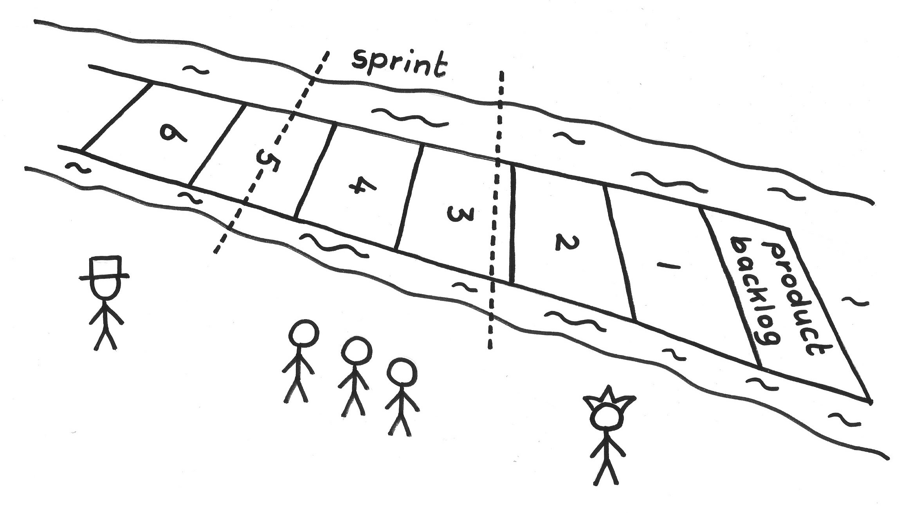
Scrum Meetings - Planning
When: At the beginning of the sprint
What: The team commits to tickets they think they can complete in the sprint Tickets are centered around a feature/goal
Why: Sets expectations for what is to be completed in the sprint
Team members have freedom to choose from a pool of tickets
Agency in the process makes the team more self-accountable

Slide 11

Scrum Meetings - Review
When: At the end of the sprint (or set of sprints)
What: Work completed is presented to an audience including (but not limited to):
Product Owner & other Stakeholders
Other Team Members
Why: Gives team members opportunity to receive feedback on completed work
Complete view of all work done shows whether it works in harmony
Motivates team members to work efficiently during sprint

Slide 12

Scrum Meetings - Retro
When: After the end of every sprint
What: The team covers the following issues together: What went well? What went poorly? What can be done to improve?
Scrum process is modified for next week based on agreed improvements
Why: Scrum process should be adaptable to needs of team/organization
Gives team members agency in how best to optimize their output
Notes:
My favorite meeting
Share examples of Retro process changes
-Standup twice a day
-Added Code Review, QA
-Made PO checking the ticket for completion part of QA
-Emphasis on Comms (Slack for comm, Trello for doc)

Slide 13
Story Time Demo
Notes:
Do the demo. Break apart the production of a short film.

Slide 14
Scrum w/ Trello
Notes:
Show Crime App

Slide 15
Q&A

